Slide 1
05January,2023
AIML Mini Project (18AIL76)
“ SENTIMENT ANALYSIS OF MOVIE REVIEWS”
Nagaabhishekha Ramadurgam-1BY19AI035
Pratiksha Rao-1BY19AI039
Puja S-1BY19AI040
Under the Guidance of:
Dr. Anupama H S
Associate Professor, AI & ML
BMSIT&M
Dr. Pradeep K R
Assistant Professor, AI & ML
BMSIT&M

Slide 2
AGENDA
Problem Statement
Literature survey
Proposed Methodology
Design and Implementation
Software and Hardware requirements
Outcome of project
Conclusion
References

Slide 3
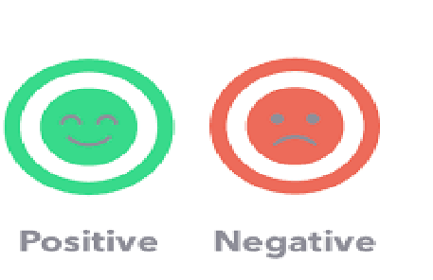
Problem Statement
Each review given as input to the model predicts a rating ranging from 0-10. For a binary classification of sentiment (positive/negative) we have considered any review below 5 as negative (assigned as 0) and any review 5 and above as positive (assigned as 1).

Slide 4
Literature Survey
TITLE | AUTHOR | PUBLISHED IN | YEAR | METHODOLOGY
Sentiment Analysis of Movie Review Using Supervised Machine Learning Techniques | Gurshobit Singh Brar , Asst. Prof. Ankit Sharma | International Journal of Applied Engineering Research | 2018 | Best thing about the system that it is a web-based API for sentiment analysis for movie reviews with JSON output to display results on any operating system
Sentiment analysis of movie reviews: A new feature-based heuristic for aspect-level sentiment classification | V. K. Singh; R. Piryani; A. Uddin; P. Waila | IEEE | 2013 | We have used a SentiWordNet based scheme with two different linguistic feature selections comprising of adjectives, adverbs and verbs and n-gram feature extraction
Sentiment Analysis Using Machine Learning Approaches (Lexicon based on movie review dataset) | Ayushi Mitra | Journal of Ubiquitous Computing and Communication Technologies | 2020 | . The strength of the sentiment classification depends on the scale of the lexicon (dictionary) because the size of the lexicon will increase this approach and becomes more incorrect and time consuming.

Slide 5
Literature Survey
TITLE | AUTHOR | PUBLISHED IN | YEAR | METHODOLOGY
A novel adaptable approach for sentiment analysis on big social data | Imane El Alaoui, Youssef Gahi, Rochdi Messoussi, Youness Chaabi, Alexis Todoskoff & Abdessamad Kobi | Journal of Big Data | 2020 | In this paper, we propose an adaptable sentiment analysis approach that analyzes social media posts and extracts user’s opinion in real-time.
Sentiment Analysis of Movie Review Using Integrated CNN-LSTM Mode | Kim, Kyoung-jae | Korea Science | 2019 | This study tries to enhance the classification accuracy of movie reviews using the integrated CNN-LSTM model.

Slide 6
Proposed Methodology
Data cleaning-
Handling missing values - Any row in the dataset containing missing values will be replaced with the mean of all rows under that column. Any HTML tags, URLs, and special characters will also be removed and the entire dataset is converted to lowercase
Natural Language processing -
Stemming - Stemming is a technique used to extract the base form of words by removing affixes from them.

Slide 7
Proposed Methodology
3) Feature extraction-
TF_IDF stands for Term Frequency - Inverse Document Frequency and is a statistical measure that aims to better define how important a word is for a document, while also taking into account the relation to other documents from the same corpus.
4) Building the machine learning model -
The overall task in this project is to classify review tweets as positive, negative or neutral. To do so we have employed multiple ML models such as Logistic Regression, Random Forest classifier, and Naive Bayes’ classifier.

Slide 8
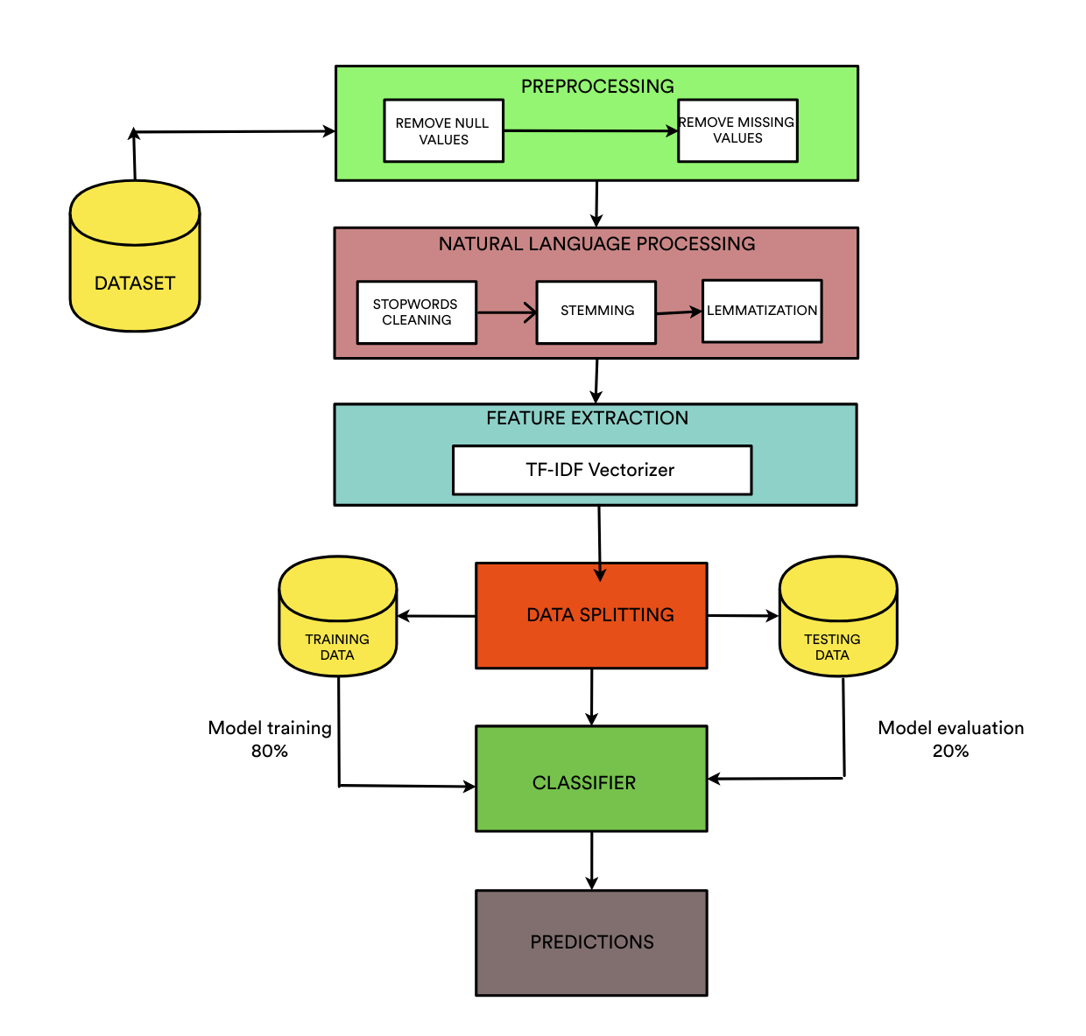
Design And Implementation

Slide 9
Software and Hardware requirements
Minimum Hardware Requirements:
RAM :Minimum 4GB
System CPU : Intel Core i5 2.6 GHz
Processor :Any Intel or AMD x86-64 processor
Internet Connection : Required
Software Requirements:
Operating : Windows 7 or More
Development Kit: Python 3.6
IDE: Google Collab/Jupyter Notebook, Visual Studio
Dataset: Kaggle

Slide 10
Outcome of project
In this project ,we are making use of the Large Movie Review Dataset ,which consists of more than 50,000 reviews. This model is designed to classify the movie reviews into positive or negative. It is achieved by performing various data pre-processing and feeding into multiple Machine Learning models. The results of each machine learning model are compared and the best one is chosen to classify the movie reviews into positive or negative .

Slide 11
Conclusion
The primary goal of this project is to build a sentiment analysis model that will enable us to understand the movie reviews we have gathered properly.

Slide 12
References
https://www.ripublication.com/ijaer18/ijaerv13n16_53.pdf
https://ieeexplore.ieee.org/abstract/document/6526500
https://irojournals.com/jucct/V2/I3/04.pdf
https://journalofbigdata.springeropen.com/articles/10.1186/s40537-018-0120-0
https://koreascience.kr/article/JAKO201909358629867.jsp-k1ff8j=SSMHB4&py=2012&vnc=v27n6&sp=588
https://www.kaggle.com/c/sentiment-analysis-on-movie-reviews
https://en.wikipedia.org/wiki/Sentiment_analysis
http://ai.stanford.edu/~amaas/data/sentiment/

Slide 13


